Slide 1
Design Patterns Object Oriented SE
Ms. Shehla Saeed

Slide 2
Architectural Style/design
An Architectural Style defines the overall structure and organization of a system at the highest level of abstraction.
👉 It answers:
How is the system organized overall?
What are the main components?
How do they interact globally?
Examples:
Client-Server: A central server provides resources to multiple client applications.
Microservices: The application is built as a collection of small, independent services that communicate over a network.
Layered (N-Tier): The system is organized into horizontal layers (e.g., presentation, business logic, database), where each layer only talks to the one directly below it.

Slide 3
Architectural Pattern (Implementation Strategy)
An Architectural Pattern is a reusable solution used to implement an architectural style.
👉 It answers:
How do we apply the style in practice?
How do components collaborate?
It adds best practices and rules to a style to guide implementation.
Examples:
MVC (Model-View-Controller) — often used in layered architectures
Broker Pattern — common in distributed systems
CORBA (Common Object Request Broker Architecture)
Message Brokers like RabbitMQ, Kafka, or Apache ActiveMQ
Notes:
CORBA is an Architectural Pattern / Middleware Architecture that enables communication between distributed objects across different systems.
👉 Developed by: Object Management Group (OMG)
🔹 Key Idea:
“Objects written in different languages and running on different machines can communicate seamlessly.”
MVC is an Architectural Pattern used to separate concerns in an application.
Components:
1. Model : Handles data & business logic
2. View : Handles UI (User Interface)
3. Controller : Handles user input & interaction
🔹 Flow:
User interacts with View
Controller receives input
Controller updates Model
Model updates View
🔹 Diagram:
User → View → Controller → Model → View
Components of Broker Pattern
🔹 1. Client
Requests services
🔹 2. Broker
Central coordinator
Finds appropriate server
Handles communication
🔹 3. Server (Service Provider)
Provides services
🔹 4. Stub (Client-side proxy)
Represents server locally
🔹 5. Skeleton (Server-side handler)
Receives request and executes it

Slide 4
Design Pattern (Low-Level Solution)
A Design Pattern is a solution to a localized problem within a small part of the system.
👉 It answers:
How should a specific piece of code be designed?
How do objects/classes interact?
Not a finished design: It is not code you can directly copy and paste.
A template: It is a description or template for how to solve a problem that can be used in many different situations.
Language Agnostic: Concepts apply to Java, C++, Python, C#, etc.
Notes:
Think of a design pattern like a blueprint.
If you want to build a house, the blueprint tells you where the walls go, but you still have to buy the bricks and lay them yourself.
Design patterns don't give you the exact code, but they give you the architectural strategy to solve a specific problem

Slide 5
Architectural vs design patterns
An Architectural Style is the application design at the highest level of abstraction; An Architectural Pattern is a way to implement an Architectural Style
A Design Pattern is a way to solve a localized problem.
In a few words, while Design Patterns impact a specific section of the code base
Architectural Patterns are high-level strategies that concern large-scale components, the global properties and mechanisms of a system.
Notes:
Architectural Style
This is the high-level view of a software system.
It defines the overall structure and how components interact.
Examples:
Client-Server
Layered Architecture
Event-Driven Architecture
Microservices Architecture
Architectural pattern
This is a specific way to implement an architectural style.
It adds best practices and rules to a style to guide implementation.
Examples:
MVC (Model-View-Controller) — often used in layered architectures
Broker Pattern — common in distributed systems
CORBA (Common Object Request Broker Architecture)
Message Brokers like RabbitMQ, Kafka, or Apache ActiveMQ
Microkernel Pattern- IDE software like Eclipse or VS Code (core + language/tool plugins)
Browser extensions — the browser is the kernel, and plugins extend it
This solves recurring, specific coding problems in part of your system.
Smaller in scope than architectural patterns.
Helps with code structure, flexibility, and reuse.
Examples:
Singleton
Observer
Factory
Strategy
Decorator

Slide 6
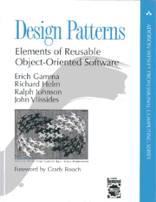
Design patterns
A Brief History (The Gang of Four)
Origin: Concept originated in civil engineering/architecture by Christopher Alexander.
Software Adoption: Popularized in 1994 by the book "Design Patterns: Elements of Reusable Object-Oriented Software".
The GoF: The four authors—Erich Gamma, Richard Helm, Ralph Johnson, and John Vlissides—are affectionately known in CS as the "Gang of Four" (GoF).
The Original 23: The book cataloged 23 fundamental patterns that are still used today.
1995 book Design Patterns: Elements of Reusable Object-Oriented Software is a classic of the field
Notes:
It's interesting that this started in physical architecture—designing buildings and towns.
The Gang of Four realized that software engineers were solving the same object-oriented problems over and over again.
By documenting these 23 patterns, they changed how software is engineered."

Slide 7
Why Use Design Patterns?
Proven Solutions: They are battle-tested by thousands of developers.
Code Reusability: Promotes writing code that is modular and adaptable.
Shared Vocabulary: Allows developers to communicate efficiently.
Instead of saying: "I wrote a class that only lets you create one instance of it and gives global access..."
You say: "I used a Singleton."
Faster Development: You don't have to reinvent the wheel.
Notes:
The biggest advantage is the shared vocabulary. When you join a tech company, your senior engineer won't explain a complex architecture from scratch.
They'll say, 'We use a Factory pattern here and an Observer pattern there.' Knowing these patterns allows you to instantly understand the system's architecture."

Slide 8
The Three Main Categories
The Gang of Four grouped the 23 patterns into three main categories based on their purpose:
Creational Patterns: Deal with object creation mechanisms.
Structural Patterns: Deal with object composition and relationships.
Behavioral Patterns: Deal with communication and assignment of responsibilities between objects.

Slide 9
Gang of Four (GoF) patterns
Creational Patterns (abstracting the object-instantiation process)
Factory Method Abstract Factory Singleton
Builder Prototype
Structural Patterns (how objects/classes can be combined)
Adapter Bridge Composite
Decorator Facade Flyweight
Proxy
Behavioral Patterns (communication between objects)
Command Interpreter Iterator
Mediator Observer State
Strategy Chain of Responsibility Visitor
Template Method
Notes:
To make it easier to digest, patterns are categorized by what they do.
Creational is about making objects.
Structural is about assembling objects into larger structures.
Behavioral is about how objects talk to each other."

Slide 10
Creational Patterns
Purpose: Hide the creation logic rather than instantiating objects directly using the new operator.
Why it matters: Gives the program more flexibility in deciding which objects need to be created for a given use case.
Common Examples:
Singleton
Factory Method
Builder
Notes:
"Using the 'new' keyword tightly couples your code to a specific class. Creational patterns help us abstract the instantiation process, making our systems independent of how their objects are created, composed, and represented."

Slide 11
Structural Patterns
Purpose: Explain how to assemble objects and classes into larger structures while keeping these structures flexible and efficient.
Focus: Interfaces and inheritance.
Common Examples:
Adapter
Decorator
Facade
Notes:
these are all about composing classes to form larger, more complex structures. They help guarantee that when one part of a system changes, the entire structure doesn't collapse."

Slide 12
Behavioral Patterns
Purpose: Concerned with algorithms and the assignment of responsibilities between objects.
Focus: How objects communicate and cooperate to perform a task.
Common Examples:
Observer
Strategy
Command
Notes:
Finally, Behavioral patterns. While creational is about 'building' and structural is about 'assembling', behavioral is about 'communicating'. It defines how objects interact and distribute the workload."

Slide 13
OOP Review
Abstract Method
Abstract class
Constructors
Concrete class
Interface

Slide 14
Abstract method
A method without body (no implementation) is known as abstract method.
Abstract method must always be declared in an abstract class, or in other words you can say that if a class has an abstract method, it should be declared abstract as well.
abstract keyword is used to create an abstract class and method.
Notes:
A method that is declared without an implementation (i.e., no body) in an abstract class or interface.
Subclasses are expected to provide the implementation.

Slide 15
Abstract Class
A class which is declared with the abstract keyword is known as an abstract class in Java.
It can have abstract and non-abstract methods (method with the body).
It can have final methods which will force the subclass not to change the body of the method.
Notes:
Cannot create objects directly from an abstract class.
Can include:
Abstract methods (no body)
Concrete methods (with body)
Fields (variables)
Constructors
Must be extended (inherited) by a subclass that provides implementation for the abstract methods.
Supports polymorphism and inheritance.

Slide 16
// Abstract class
abstract class Animal {
// Abstract method (does not have a body)
public abstract void animalSound();
// Regular method
public void sleep() {
System.out.println("Zzz");
}
}
// Subclass (inherit from Animal)
class Dog extends Animal {
public void animalSound() {
// The body of animalSound() is provided here
System.out.println("The dog says: woof woof");
}
}
class MyMainClass {
public static void main(String[] args) {
Dog myDog = new Dog(); // Create a Dog object
myDog.animalSound();
myDog.sleep();
}
}
Notes:
Abstract Class: Animal is an abstract class. That means:
You cannot create an object of Animal.
It can have abstract methods (without body).
It can also have regular methods (with body).
Abstract Method:
animalSound() is abstract → no body in Animal, but every subclass must implement it.
Subclass (Dog):
Inherits from Animal.
Provides body for the abstract method animalSound().
Main Method:
Pig myDog = new Dog(); creates an object of the Dog class.
myDog.animalSound(); calls the implemented method → prints pig's sound.
myDog.sleep(); calls the regular method from the parent class.
🖨️ Output:
The Dog says: woof woof
Zzz
Why Use Abstract Classes?
They’re useful when:
You want to define a common base for many subclasses.
Some methods should be mandatory to implement, while others can be optional.

Slide 17
Constructor
Constructor is a block of code that initializes the newly created object.
public class Hello
{
String name;
//Constructor
Hello()
{
this.name = "BeginnersBook.com";
}
public static void main(String[] args)
{
Hello obj = new Hello();
System.out.println(obj.name);
}
}
Notes:
A constructor is a special method in a class that is automatically called when an object of the class is created. Its main purpose is to initialize the object — for example, setting initial values of fields.
Has the same name as the class (in languages like Java, C++).
No return type, not even void.
Can be overloaded (multiple constructors with different parameters).
Can be default (no parameters) or parameterized (takes arguments).
In Python, the constructor is always named __init__.
TypeDescription
Default ConstructorTakes no parameters, used to set default values
Parameterized ConstructorTakes arguments, allows setting custom values
Copy Constructor (C++, optional in others)Creates a new object by copying another
public class Hello
{
String name;
A class Hello is defined.
It has an instance variable name of type String.
// Constructor
Hello()
{
this.name = "BeginnersBook.com";
}
This is a constructor — it’s a special method that runs automatically when an object of the class is created.
this.name refers to the current object’s name variable, and it assigns it the string "BeginnersBook.com".
public static void main(String[] args)
{
Hello obj = new Hello();
System.out.println(obj.name);
}
Inside the main method:
A new object obj of class Hello is created.
The constructor is called automatically and sets obj.name to "BeginnersBook.com".
System.out.println(obj.name); prints that value.
output
BeginnersBook.com
🧠 Why is this useful?
Constructors are commonly used to:
Initialize values when an object is created.
Provide default or custom setups for object creation.
Avoid setting values manually after creating an object.

Slide 18
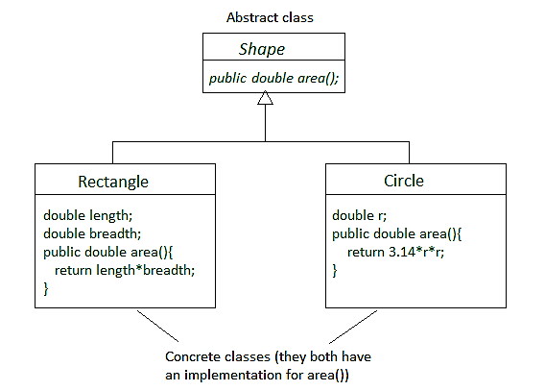
Concrete Class
A concrete class is a class that has an implementation for all of its methods.
They cannot have any unimplemented methods.
It can also extend an abstract class or implement an interface as long as it implements all their methods.
Notes:
A concrete class is a class that has a complete implementation — meaning:
✅ All its methods are fully defined (no abstract methods). ✅ It can be instantiated — you can create objects from it. ✅ It can inherit from abstract classes or implement interfaces and must provide code for all inherited abstract methods.
🔹 Key Characteristics
Can be used to create real objects.
Can include fields, methods, constructors, etc.
Can extend abstract classes and implement interfaces.
Represents actual implementations of behaviors and properties.

Slide 19
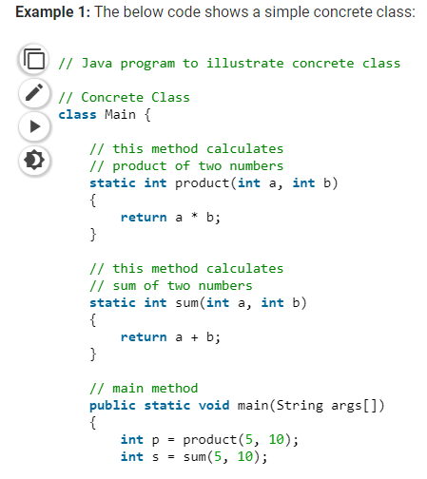
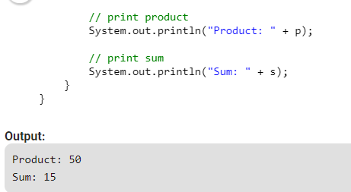
Notes:
This is a Java program that defines a concrete class named Main. It includes:
Two static methods:
product(int a, int b) → multiplies two integers.
sum(int a, int b) → adds two integers.
A main method that calls these methods and prints the results.
class Main {
This is a concrete class — it's complete and can be used directly (you can create objects or call static methods from it).
static int product(int a, int b) {
return a * b;
}
This method multiplies two integers and returns the result.
static int sum(int a, int b) {
return a + b;
}
This method adds two integers and returns the result.
public static void main(String args[]) {
int p = product(5, 10); // calls the product method: 5 * 10 = 50
int s = sum(5, 10); // calls the sum method: 5 + 10 = 15
The main method is the entry point.
It calls both methods with 5 and 10 as arguments.
Stores the results in variables p (product) and s (sum).

Slide 20
Concrete Method
A concrete method means, the method has complete definition but it can be overridden in the inherited class.
If we make this method "final" then it can not be overridden.
Declaring a method or class "final" means its implementation is complete.
Notes:
A concrete method is a fully implemented method — it has both a name, parameters, and a body (code that performs an action).
You can call it directly, and it does something when called.
Characteristics:
Belongs to a class (can be in regular or abstract classes).
Has a body with logic.
Unlike abstract methods, it is not abstract.
Can be inherited or overridden by subclasses.

Slide 21
// Abstract class
abstract class Animal {
// Abstract method (does not have a body)
public abstract void animalSound();
// Regular method
public void sleep() {
System.out.println("Zzz");
}
}
// Subclass (inherit from Animal)
class Dog extends Animal {
public void animalSound() {
// The body of animalSound() is provided here
System.out.println("The dog says: woof woof");
}
}
class MyMainClass {
public static void main(String[] args) {
Dog myDog = new Dog(); // Create a Dog object
myDog.animalSound();
myDog.sleep();
}
}
Notes:
abstract class Animal
This is an abstract class — you cannot create objects directly from it.
It contains:
A concrete method: sleep(), which has an implementation.
An abstract method: makeSound(), which has no body — it must be implemented in a subclass.
2. class Dog extends Animal
Dog is a subclass of Animal. It inherits everything from Animal.
Since Animal has an abstract method makeSound(), Dog must implement it.
Dog provides its own version of makeSound() which prints "Woof!".
3. public class Main { ... }
This is the class with the main() method — the entry point of the program.
Inside main():
Dog d = new Dog();
Creates a new Dog object.
d.makeSound(); // Calls Dog's method
Executes the makeSound() method → prints "Woof!"
d.sleep(); // Inherited from Animal
Executes the sleep() method from the parent class → prints "Zzz"
Output of the Program:
CopyEdit
Woof! Zzz

Slide 22
Interface
An interface is similar to class.
It is a collection of abstract methods.
A class implements an interface, thereby inheriting the abstract methods of the interface.
an interface may inherit multiple interfaces and a class may implement multiple interfaces.

Slide 23
Interface
A Java class can only extend one parent class.
Multiple inheritance ( extends ) is not allowed.
Interfaces are not classes, however, and a class can implement more than one interface.
The parent interfaces are declared in a comma-separated list, after the implements keyword.
Notes:
n interface is a contract or blueprint that defines a set of methods (and sometimes properties) that a class must implement.
It contains only method signatures (no implementation — unless you're in a modern language that allows default methods).
A class that implements an interface must provide code for all its methods.

Slide 24
// Interface
interface Animal {
public void animalSound(); // interface method (does not have a body)
public void sleep(); // interface method (does not have a body)
}
// Dog "implements" the Animal interface
class Dog implements Animal {
public void animalSound() {
// The body of animalSound() is provided here
System.out.println("The dog says: woof woof");
}
public void sleep() {
// The body of sleep() is provided here
System.out.println("Zzz");
}
}
class MyMainClass {
public static void main(String[] args) {
Dog myDog = new Dog(); // Create a Dog object
myDog.animalSound();
myDog.sleep();
}
}
Notes:
What the Code Does:
Defines an interface Animal with two methods: animalSound() and sleep().
A class Dog implements the Animal interface
and provides concrete implementations for those two methods.
In MyMainClass, it creates a Dog object and calls both methods.
Output
The Dog says: woof woof
Zzz
Why thi happens:
The interface Animal forces Dog to implement the behavior.
myDog.animalSound() calls the overridden method in Dog.
myDog.sleep() does the same for the sleep() method.

Slide 25
Real-world Analogy
Interface: A vehicle should have start(), stop(), drive() methods — just rules.
Abstract Class: A generic Vehicle class defines some common behavior (e.g., fuelCapacity) but leaves others like drive() to be defined by specific vehicles.
Concrete Class: A Car or Bike class implements all the methods — you can now make actual car/bike objects from it.

